Slide 1
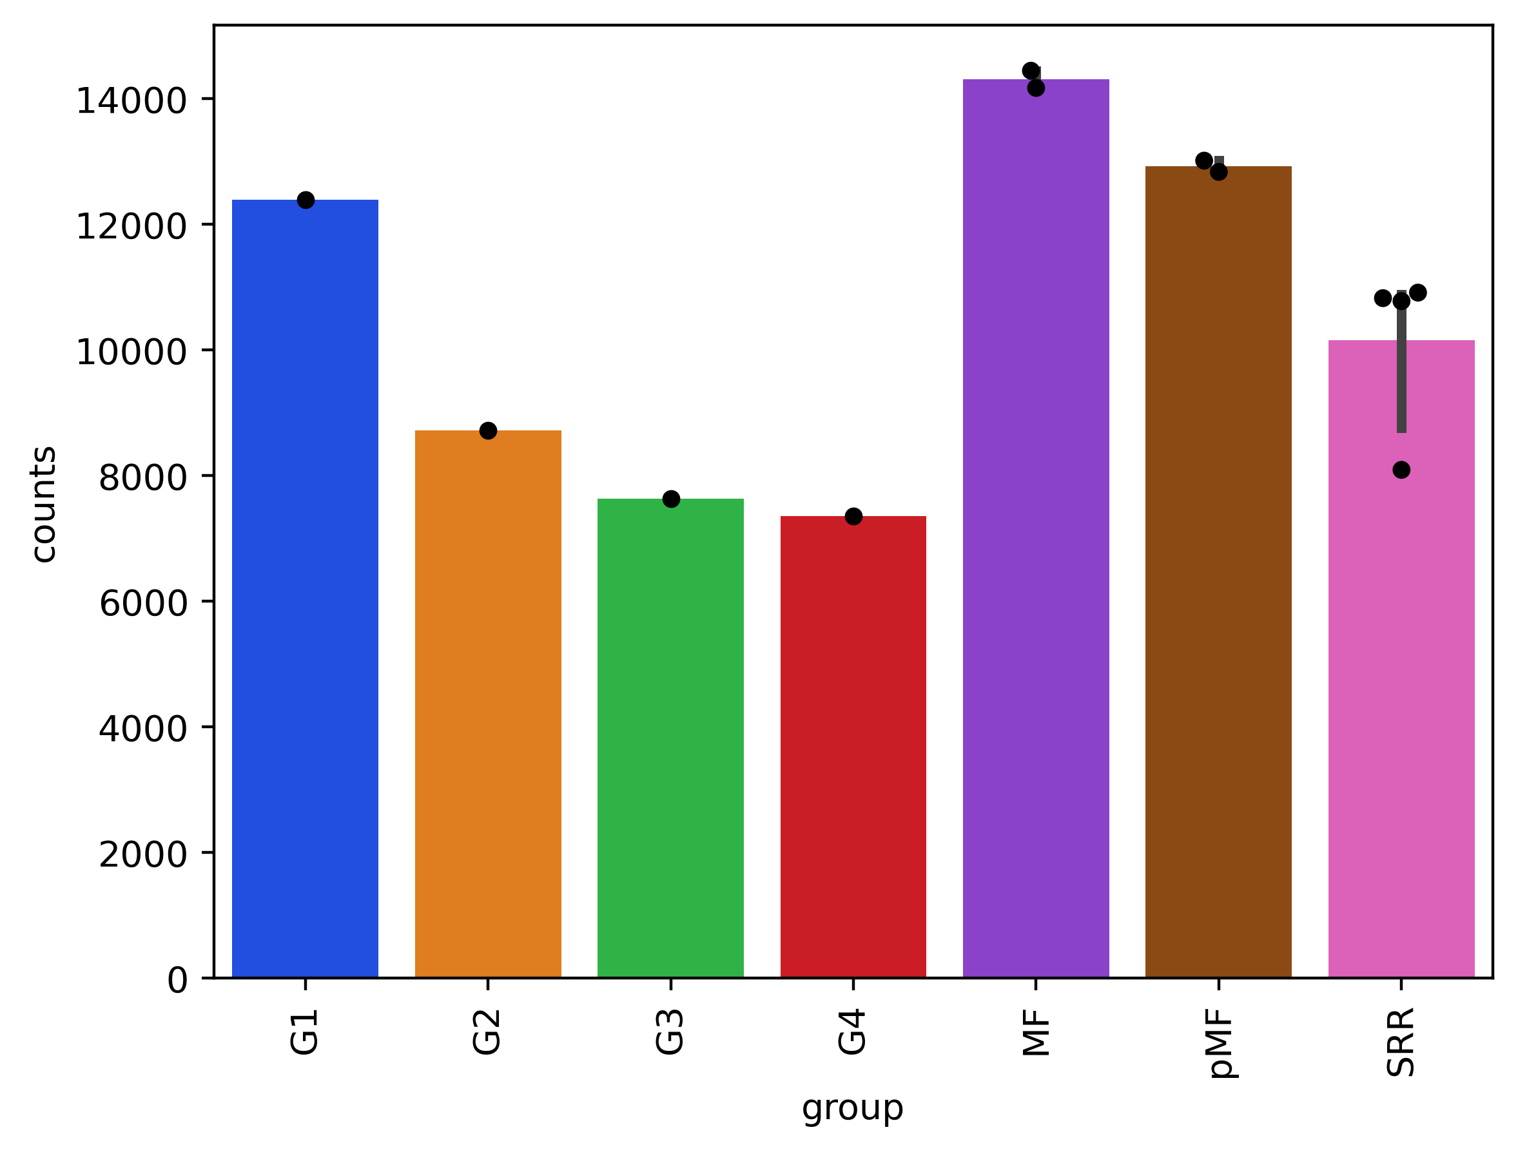
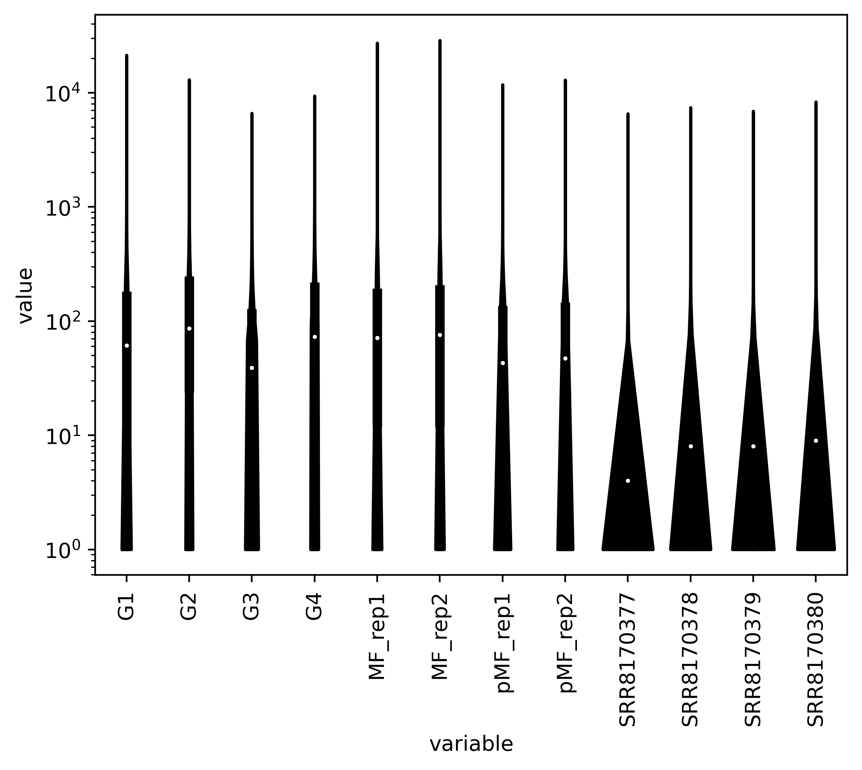
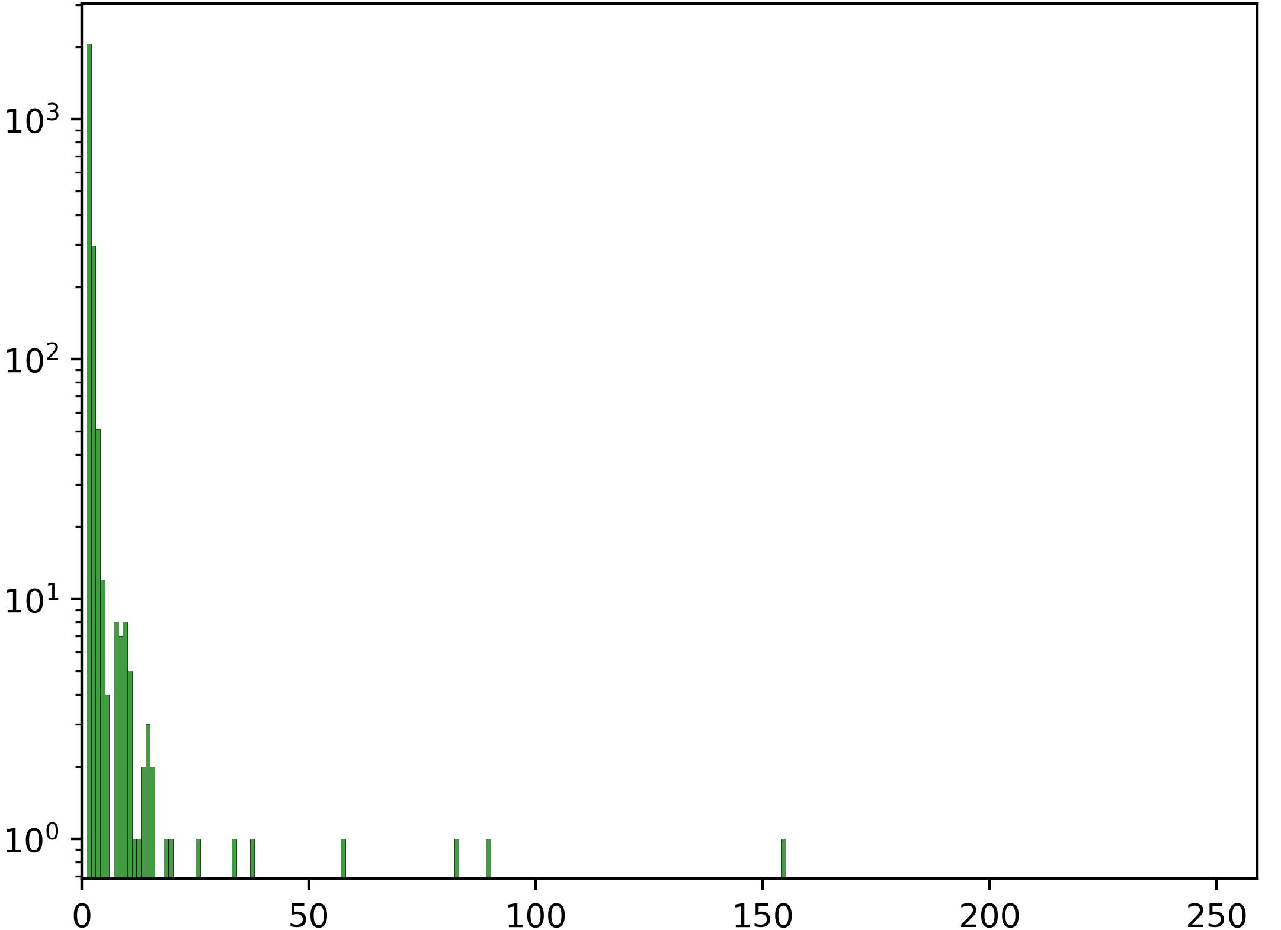
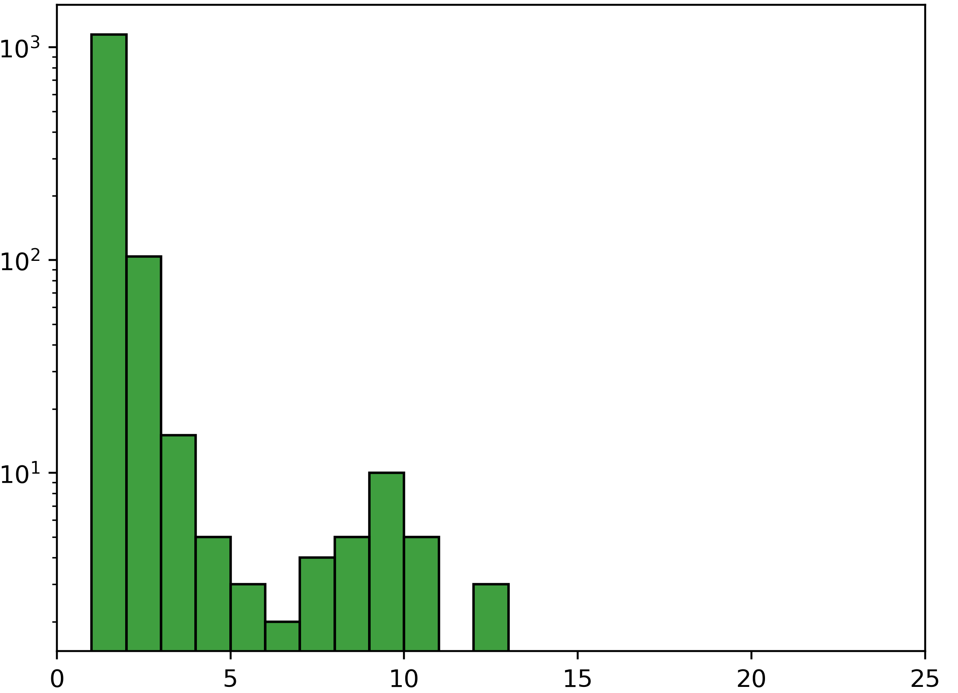
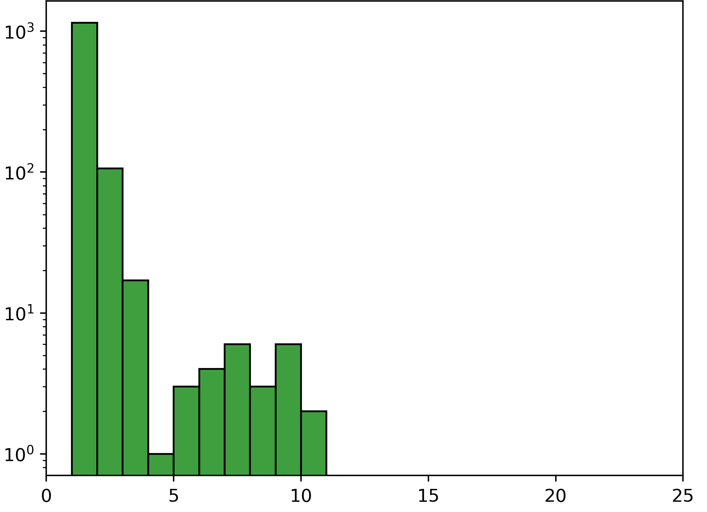
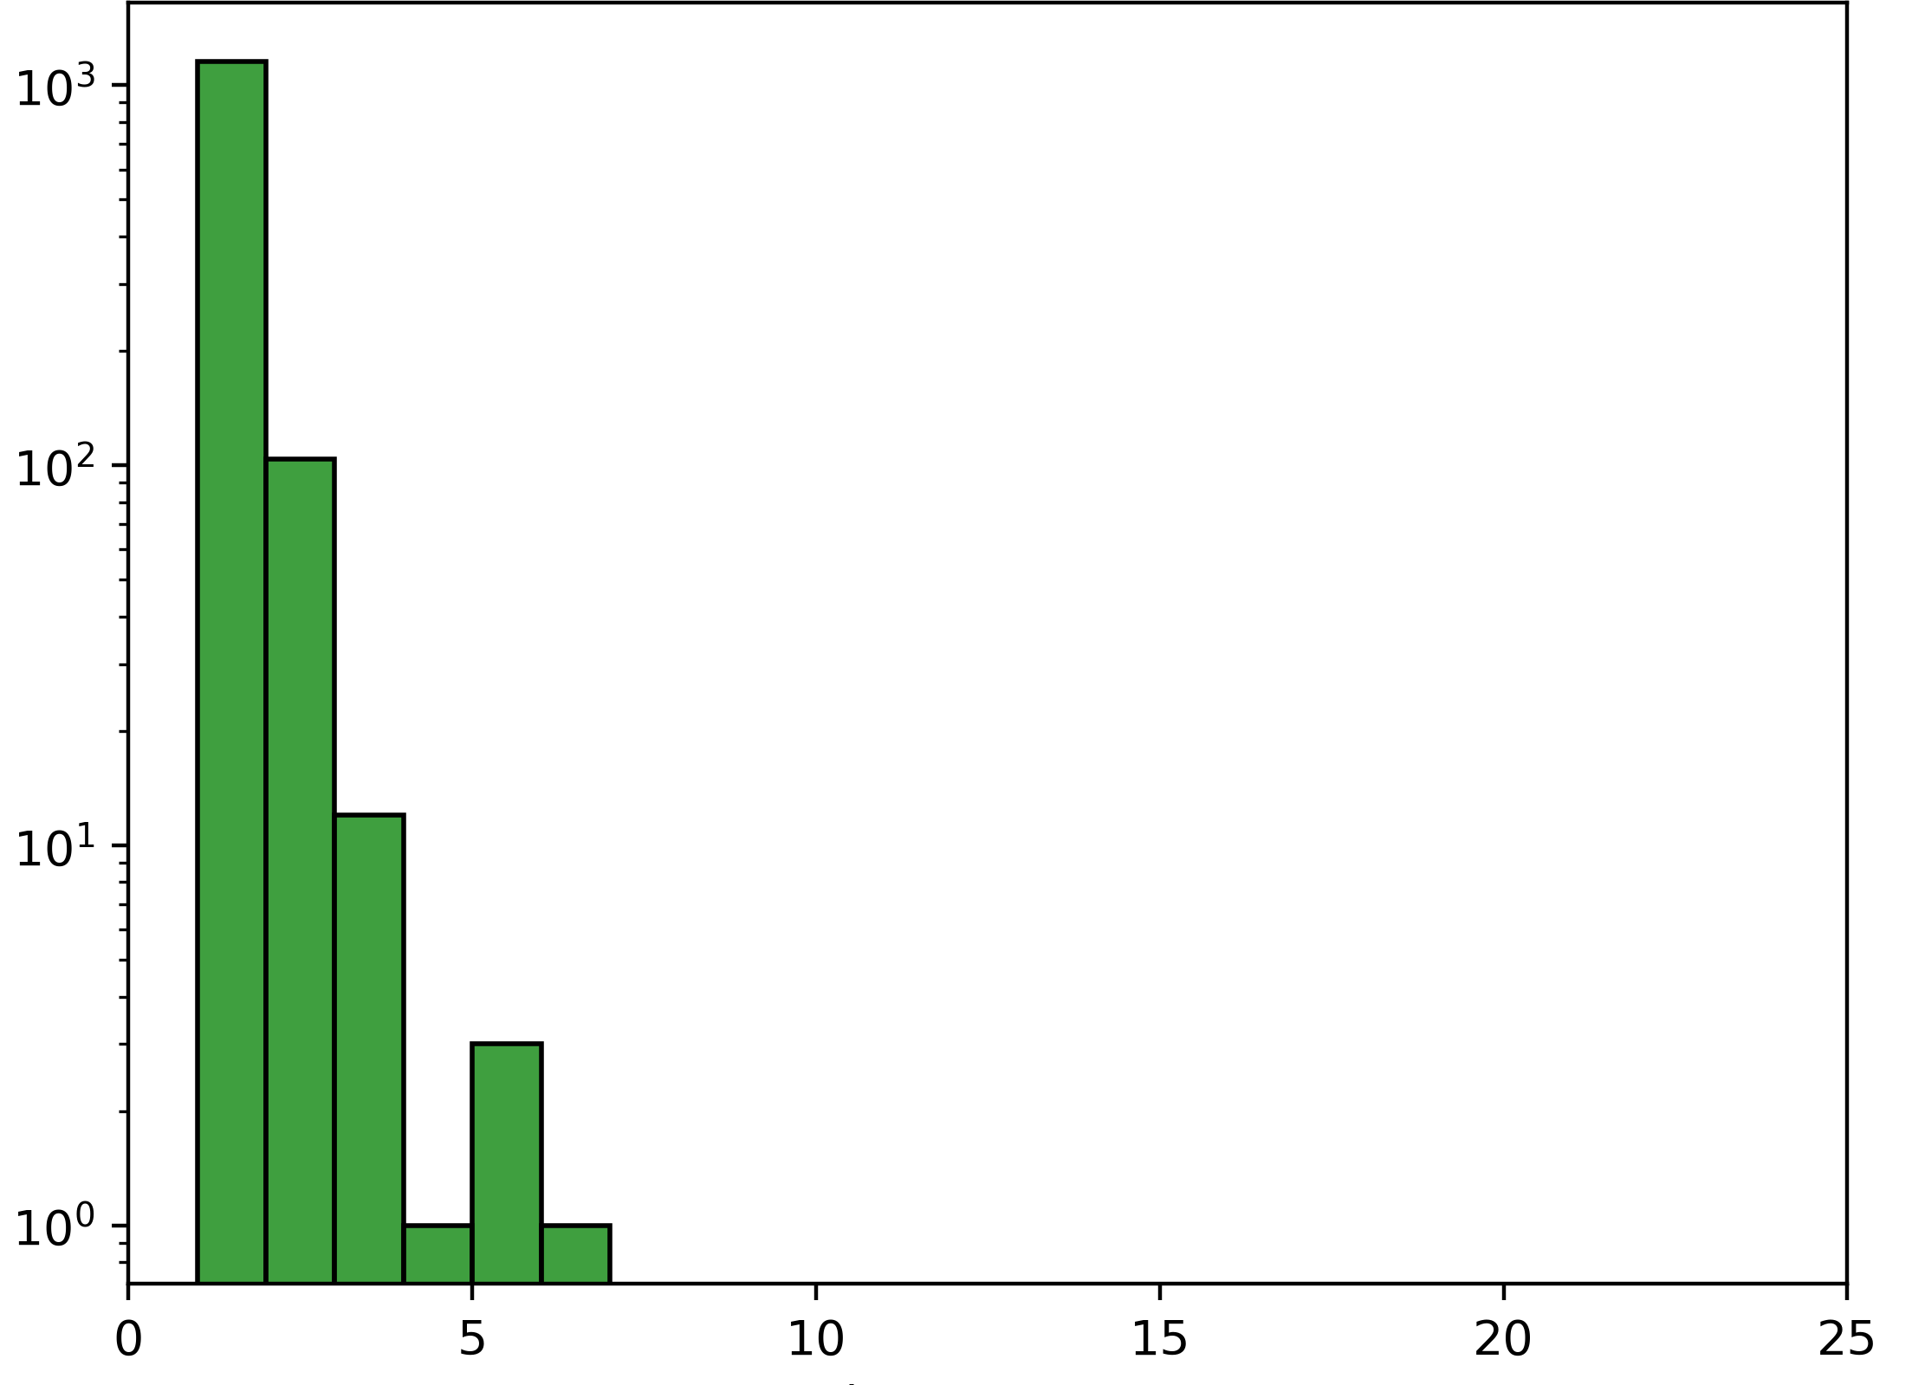
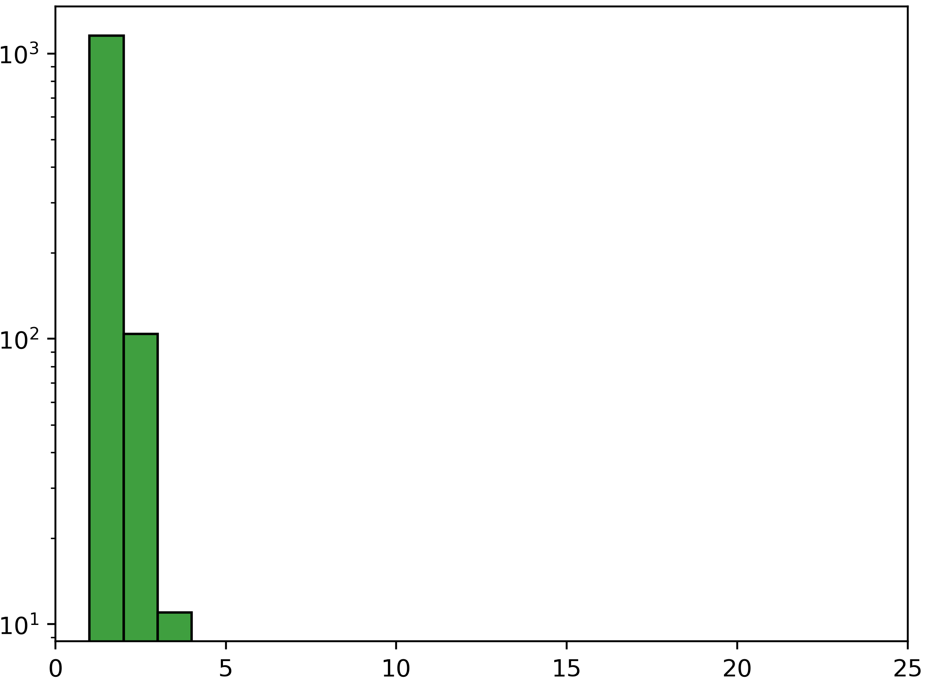
A
B
Unique genes with p-m⁵C
Unique p-m⁵c sites per gene
MT-A
MT-B
MT-C
MT-D
MT-D
Huang 3
MT-A
Huang 1
MT-B
Huang
MT-C
Huang 2
Huang 4
C
C-cutoff: None
Gini index: 0.3623
C-cutoff: 15
Gini index: 0.2320
C-cutoff: 8
Gini index: 0.1796
C-cutoff: 5
Gini index: 0.1005
Unique Genes
C-cutoff: 4
Gini index: 0.0905
C-cutoff: 3
Gini index: 0.0819
C-cutoff: 2
Gini index: 0.0791
C-cutoff: 1
Gini index: 0.0673
p-m⁵C Count per gene
Supplementary Figure 6. (A) Number of unique genes that carry p-m⁵C sites with at least 10x coverage. (B) Number of unique p-m⁵C site locations with at least 10x coverage for each bisulfite converted library. (C) Effect of the C-cutoff filter on the number of unique genes in a library. Total RNA replicate 1 is used as a representative sample.
Notes:
A) Number of unique genes that carry p-m⁵C sites with at least 10x coverage. Points represent individual libraries B) Number of unique p-m⁵C site locations with at least 10x coverage for each bisulfite converted library.

